Slide 1
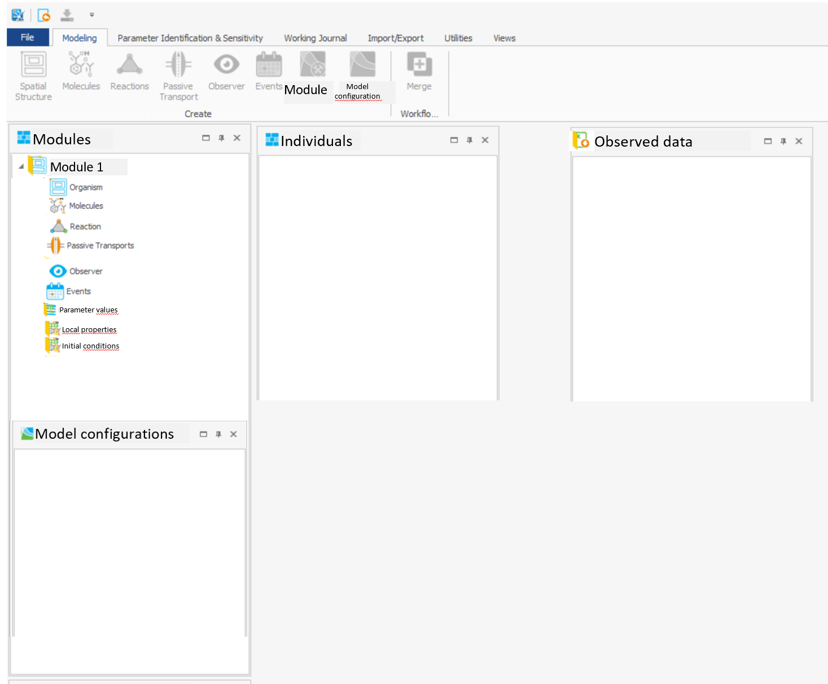
Modularization Concept
User Interface Draft

Slide 2
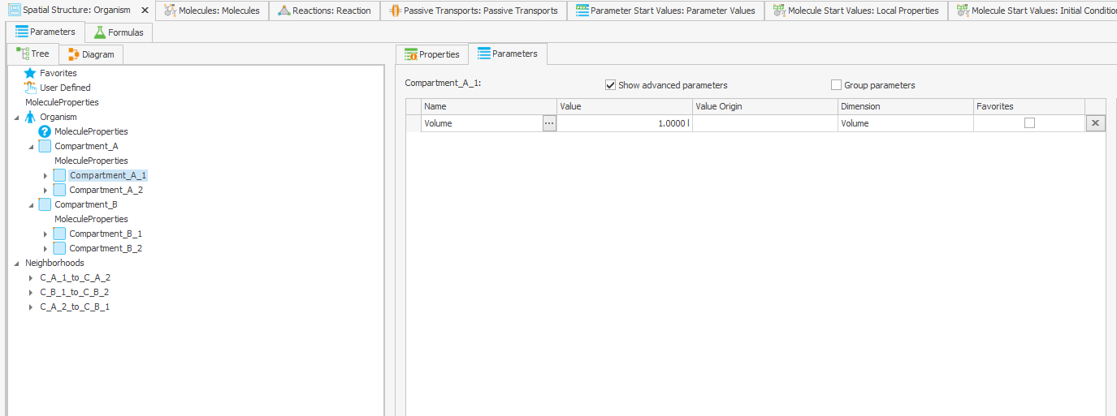
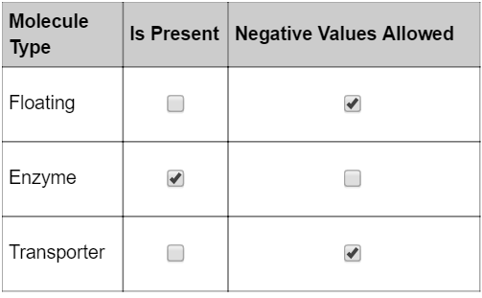
Extension Module 1
Kidney - generic population of „isPresent“ properties
Spatial Structure-BB
Default molecule behavior

Slide 3
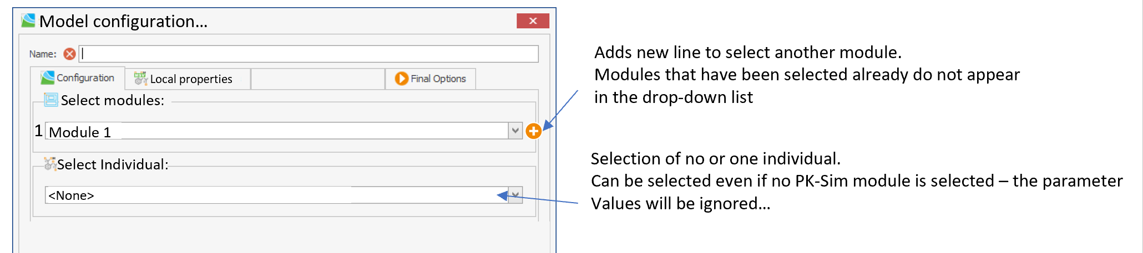
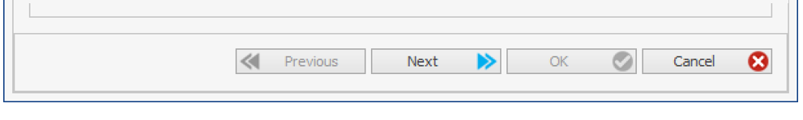
Modularization Concept
User Interface Draft

Slide 4
Module1
SS BB:
Comp1
Comp2
Comp3
Molecules BB:
Mol1
Mol2
Mol3
IC:
-M1Mol1:M1Comp1
-M1Mol1:M1Comp2
-M1Mol1:M1Comp3
-M1Mol2:M1Comp1
-M1Mol2:M1Comp2
-M1Mol2:M1Comp3
-M1Mol3:M1Comp1
-M1Mol3:M1Comp2
-M1Mol3:M1Comp3
-M1Mol1:M3Comp1
-M1Mol2:M3Comp1
-M1Mol3:M3Comp1
-M1Mol1:M3Comp1
-M1Mol2:M3Comp1
-M1Mol3:M3Comp1
-M1Mol1:M4Comp1
-M1Mol2:M4Comp1
-M1Mol3:M4Comp1
Module 2 – Glucose „healthy“
SS BB:
-
Molecules BB:
Mol1
IC:
-M2Mol1:M1Comp1
-M2Mol1:M1Comp2
-M2Mol1:M1Comp3
-M2Mol1:M3Comp1
-M2Mol1:M4Comp1
Module 2 – Glucose „diabetes“
SS BB:
-
Molecules BB:
-
IC:
-M2Mol1:M1Comp1
-M2Mol1:M1Comp2
-M2Mol1:M1Comp3
-M2Mol1:M3Comp1
-M2Mol1:M4Comp1
IS THIS ALLOWED?
HOW TO GET THIS BB?
Module 3
SS BB:
Comp1
Molecules BB:
-
IC:
Module 4
SS BB:
Comp1
Molecules BB:
Mol1
IC:
-M4Mol1:M1Comp1
-M4Mol1:M1Comp2
-M4Mol1:M1Comp3
-M4Mol1:M3Comp1
-M4Mol1:M4Comp1

Slide 5
Module1
SS BB:
Comp1
Comp2
Comp3
Molecules BB:
Mol1
Mol2
Mol3
IC:
-M1Mol1:M1Comp1
-M1Mol1:M1Comp2
-M1Mol1:M1Comp3
-M1Mol2:M1Comp1
-M1Mol2:M1Comp2
-M1Mol2:M1Comp3
-M1Mol3:M1Comp1
-M1Mol3:M1Comp2
-M1Mol3:M1Comp3
-M1Mol1:M3Comp1
-M1Mol2:M3Comp1
-M1Mol3:M3Comp1
-M1Mol1:M3Comp1
-M1Mol2:M3Comp1
-M1Mol3:M3Comp1
-M1Mol1:M4Comp1
-M1Mol2:M4Comp1
-M1Mol3:M4Comp1
Module 2 – Glucose
SS BB:
-
Molecules BB:
Mol1
IC „Healthy“:
-M2Mol1:M1Comp1
-M2Mol1:M1Comp2
-M2Mol1:M1Comp3
-M2Mol1:M3Comp1
-M2Mol1:M4Comp1
IC „Diabetes“:
-M2Mol1:M1Comp1
-M2Mol1:M1Comp2
-M2Mol1:M1Comp3
-M2Mol1:M3Comp1
-M2Mol1:M4Comp1
Module 3
SS BB:
Comp1
Molecules BB:
-
IC:
Module 4
SS BB:
Comp1
Molecules BB:
Mol1
IC:
-M4Mol1:M1Comp1
-M4Mol1:M1Comp2
-M4Mol1:M1Comp3
-M4Mol1:M3Comp1
-M4Mol1:M4Comp1

Slide 6
model configuration
PK-Sim module (0-n)
Individual (0-1)
Expression (0-n)
xModule (0-n)
Spatial Structures
Molecules
Reactions
PT
Observers
Events
IC
PV
multiple IC and PV per module? and select the right one?

Slide 7
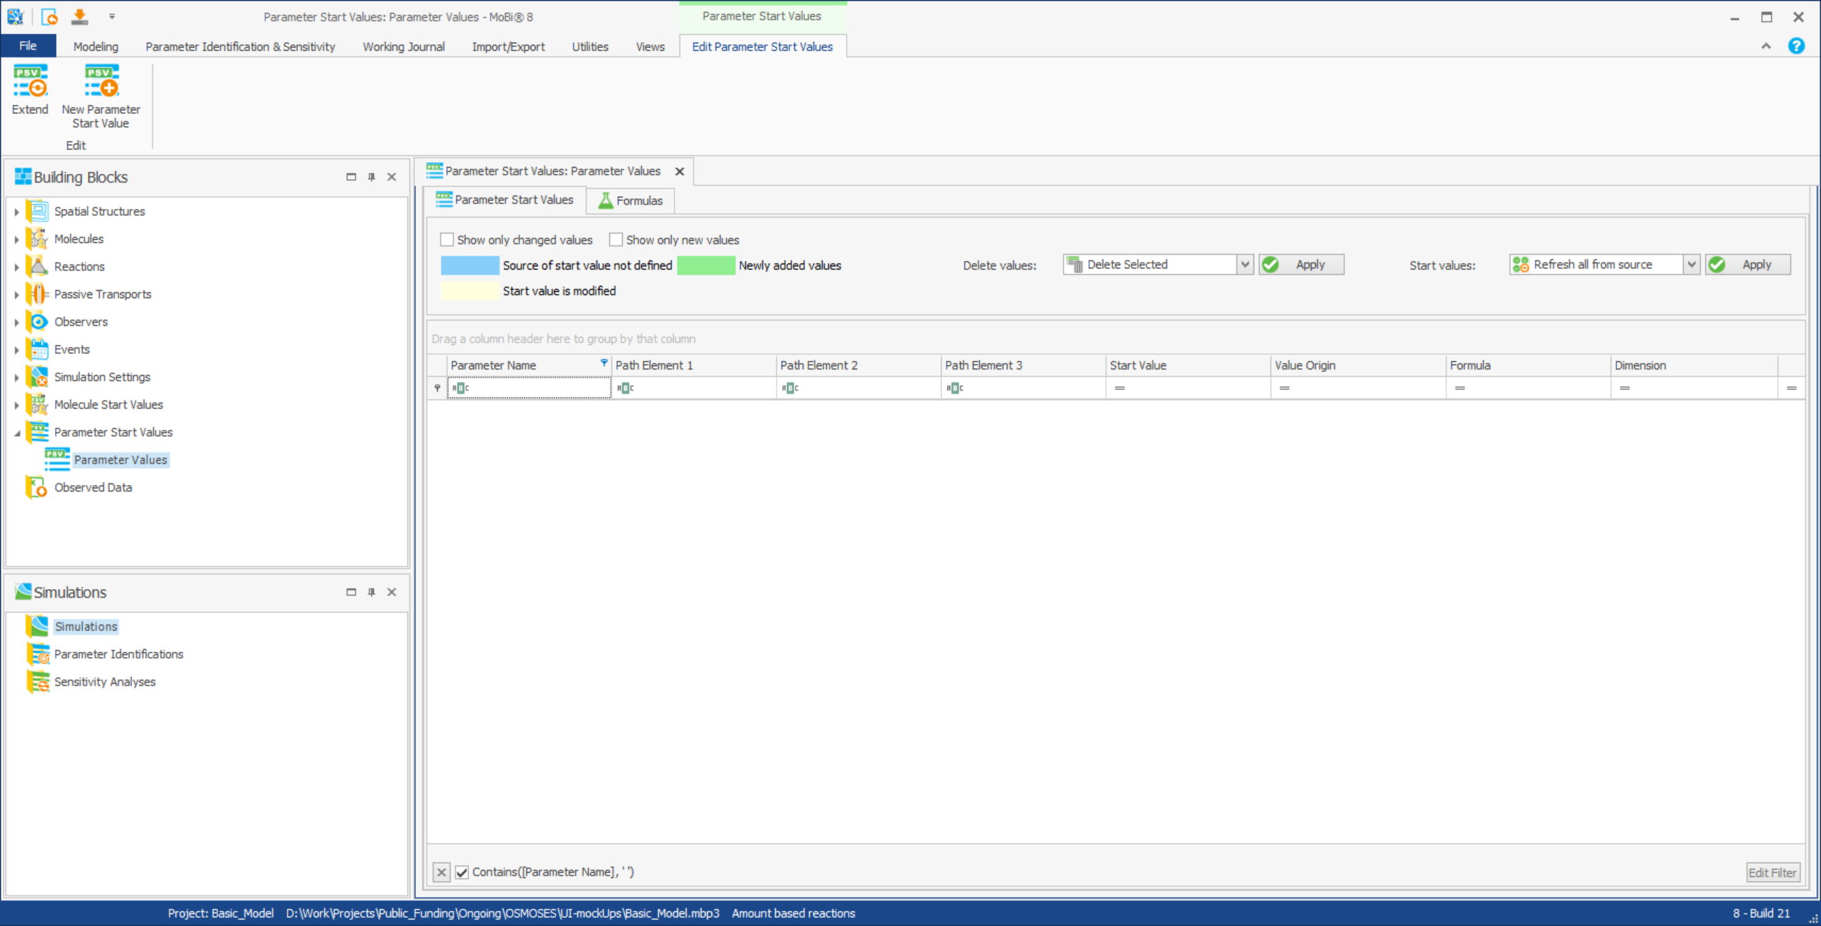
Basic model – PV - Empty by default!
Opens a selection window with parameters tree
No extend

Slide 8
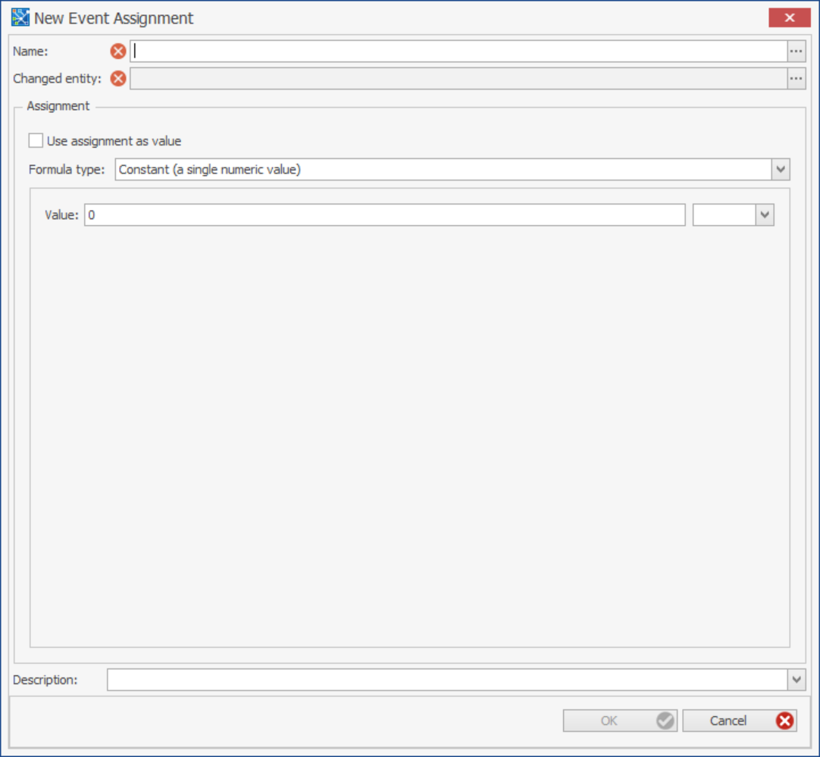
Basic model – PV – Adding new entry
Parameter path:
Manual input or tree selection
Value:
Click…

